Slide 1
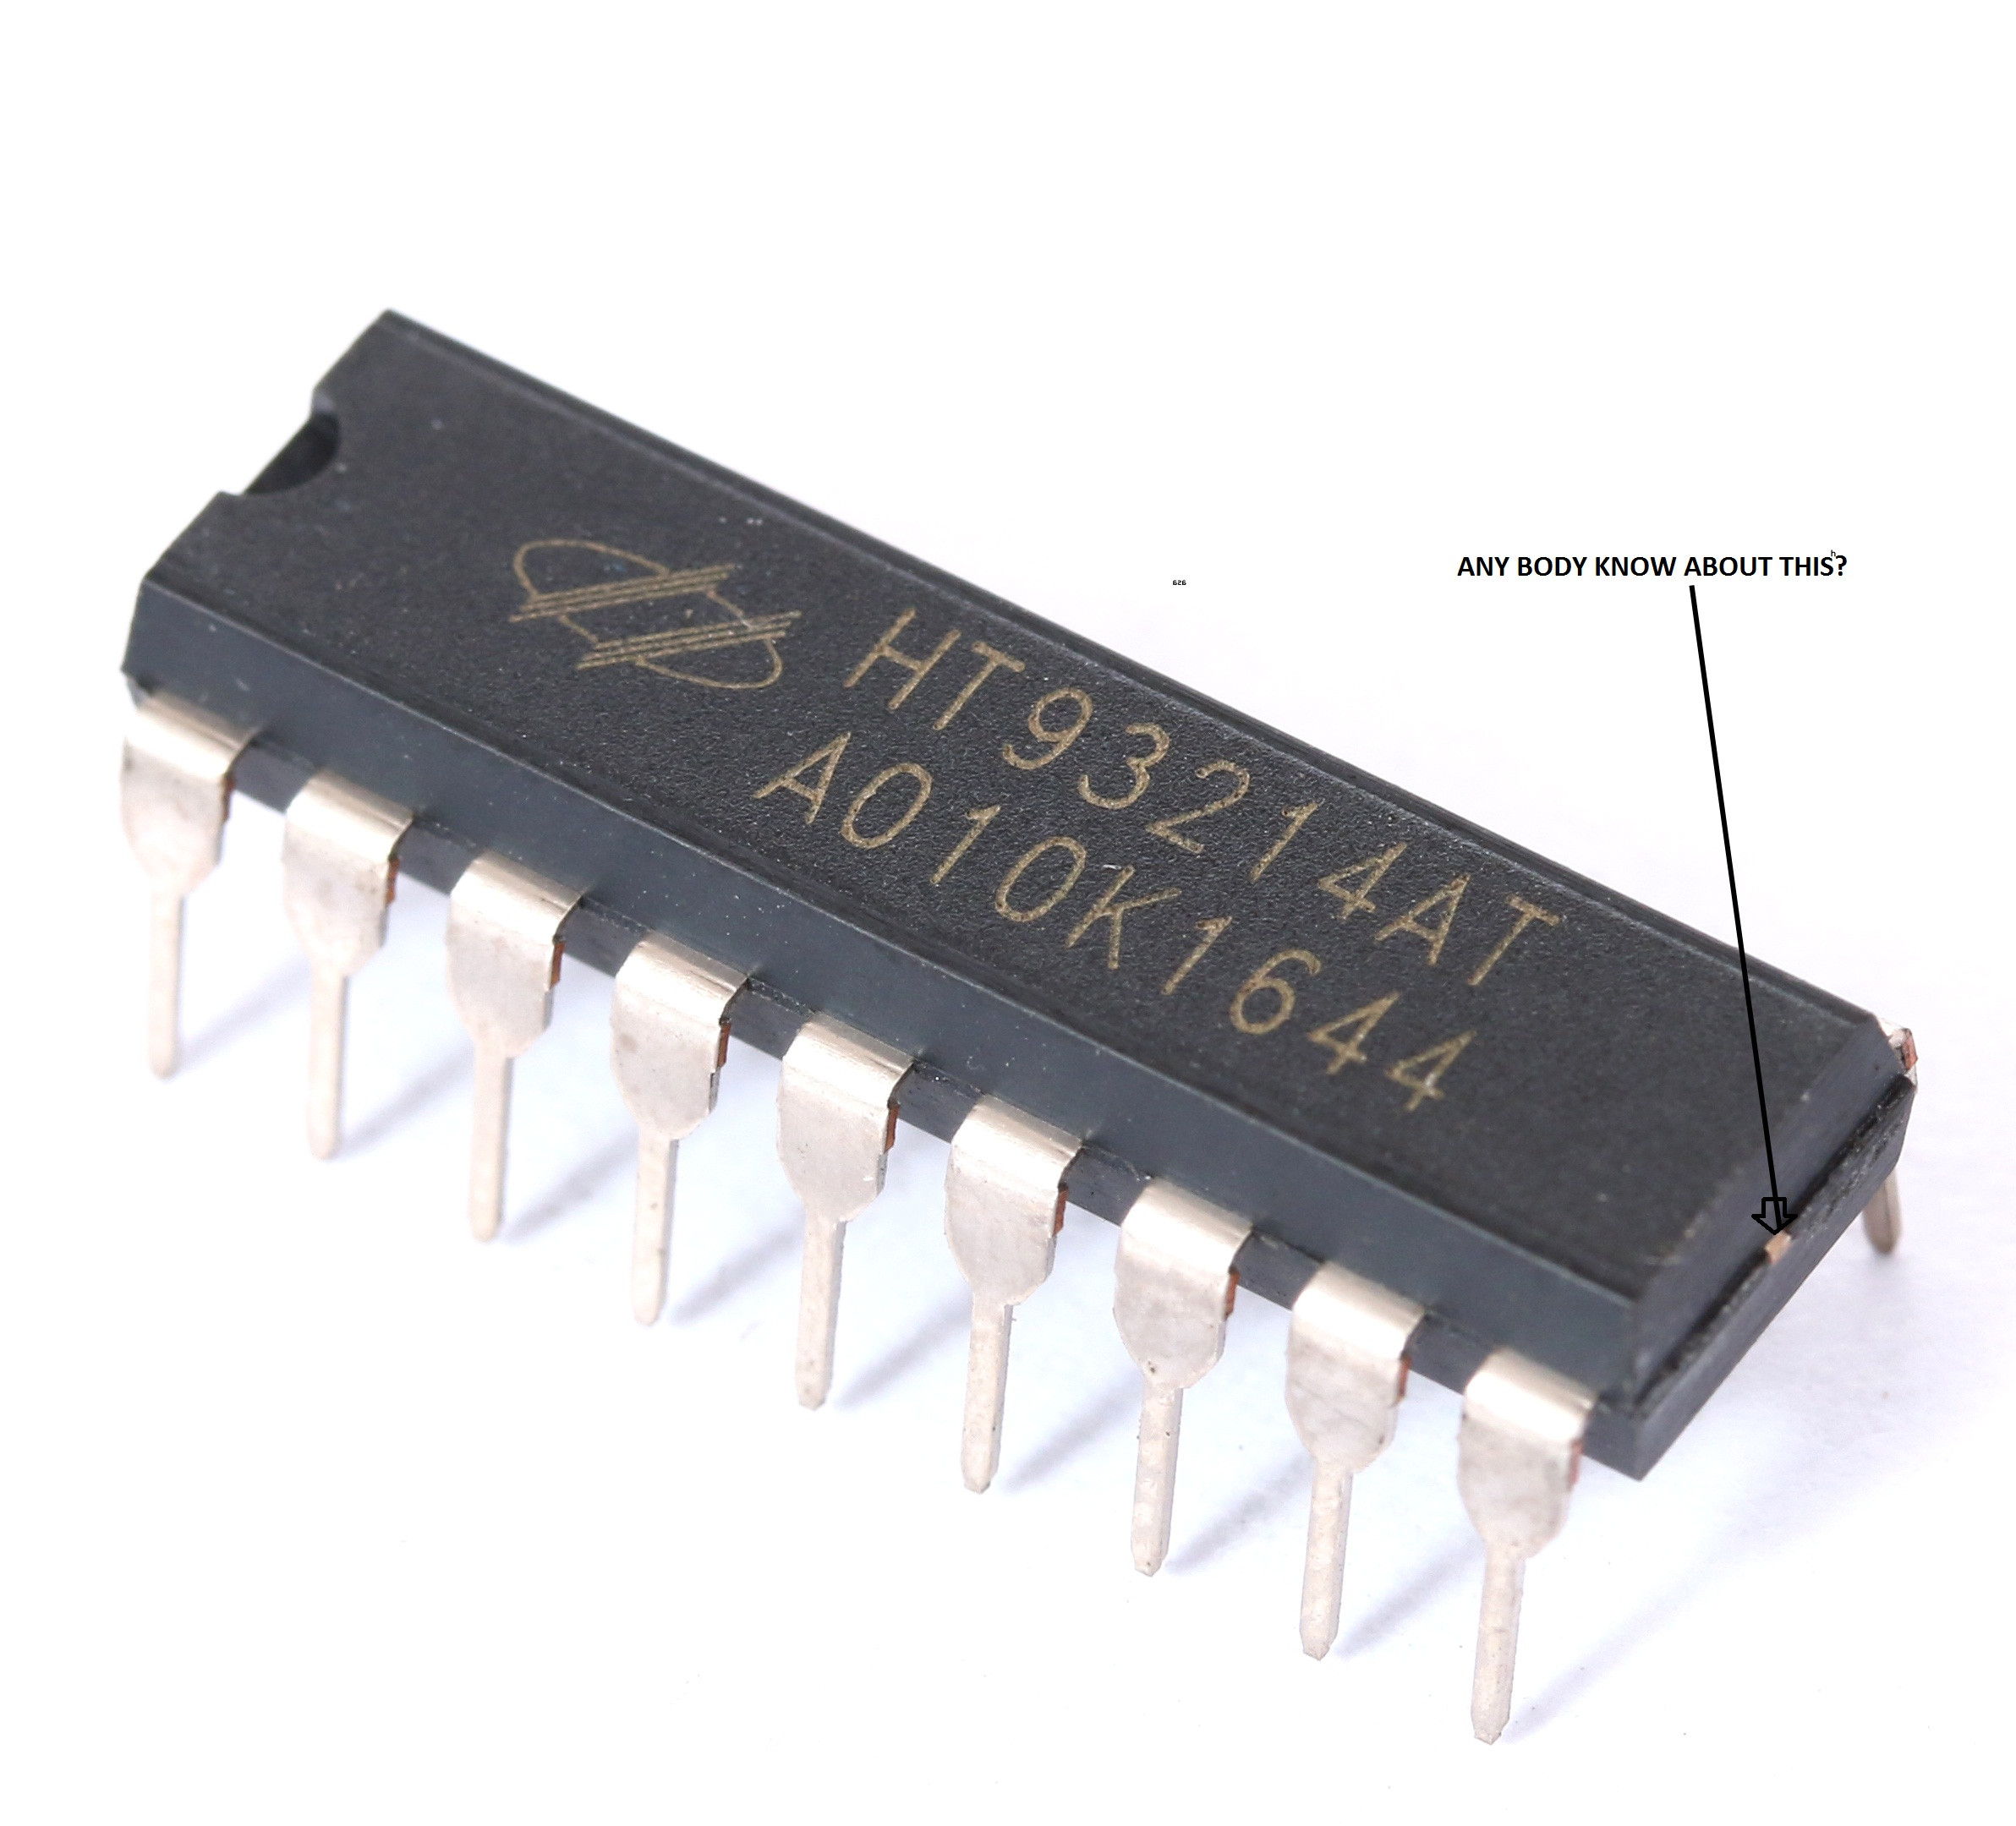
INTEGRATED CIRCUITS and dimension integrated circuits
BY,
K.JANARTHANAN. and s.mariselvi.
3 rd year of ece,
scadcet.

Slide 2
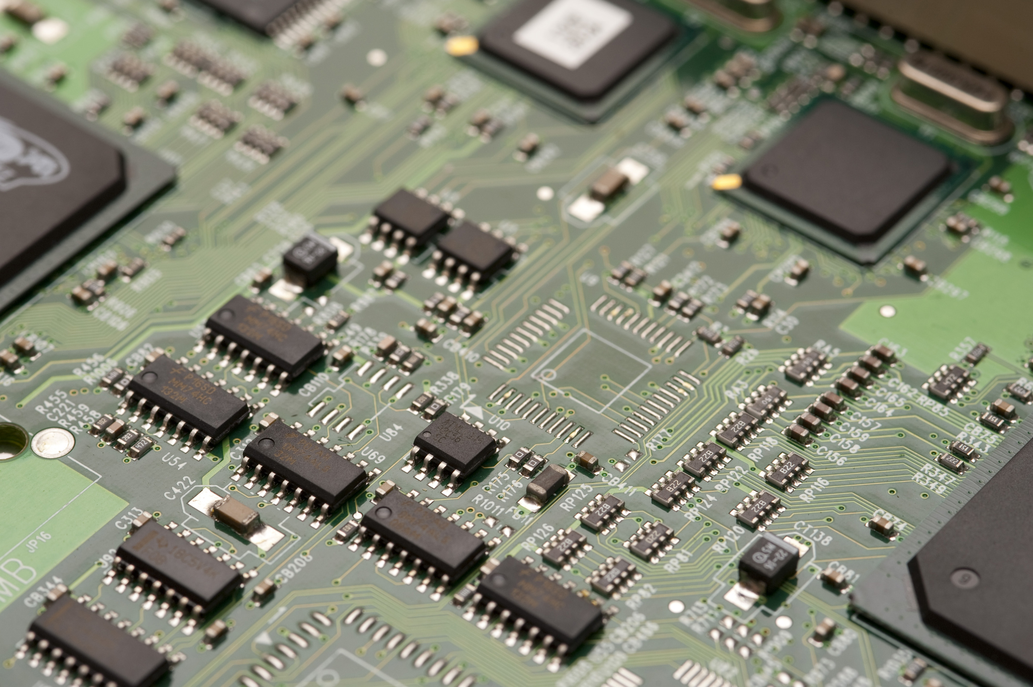
Agenda :
What is ic Evaluation of ic
Necessity of ic
Ic packing technics
2.5 D IC
3 D IC
technologies of 3D ic
merits
Demerits

Slide 3
What is ic
Integrated Circuits is defined as a microchip on which billions of electrical components, such as resistors, capacitors, transistors, conducting pathways are fabricated.
An IC functions as an oscillator, amplifier, microprocessor, timer or as computer memory.

Slide 4
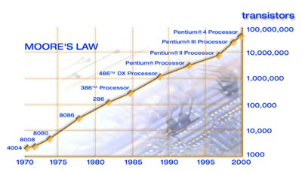
Moore’s law:
Moore's law is a term used to refer to the observation made by Gordon Moore ( co-founder of intel ) in 1965 that “the number of transistors in a integrated circuit Doubles about every two years”.(26 months)
The capability and speed of ic was increased couple of year.
the growth of micro processor is exponential.

Slide 5
Evaluation of ic:
year | density of integration | Transistor per ic
1960 | Small scale integration (logic gates) | Below 10
1967 | Medium scale integration ( flip flops, combinational circuits) | 10-100
1972 | Large scale integration ( small memory chips, programable logic device) | 100-10,000
1978 | Very large scale integration ( large memory chips , complex programable logic device) | 10,000 -1,00,000
1989 | Ultra large scale integration ( 8 & 16 micro processor ) | 1,00,000-10,00,000
2000 | Giga scale integration ( Pentium iv processor) | Above 10,00,000

Slide 6
Need of integrated circuits:
reduce the components size.
Low price.
Small size.
Power consumption is less.
Reliability.
Less cost.
Less weight.
Replacement can be done very easily.
More consistent.
Improved operating speed & performance.

Slide 7
Ic packing technics:
1)Single die chip
2)Multi chip module
3)System on chip
4)System in package
die- it is the square of silicon containing an integrated circuit that has been cut of the wafer.
Wafer- it is cut into many pieces, each containing one copy of the circuit.

Slide 8
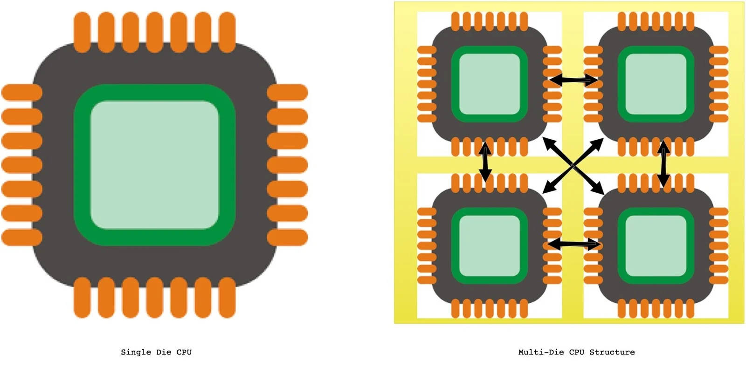
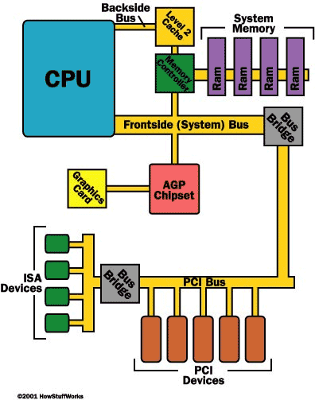
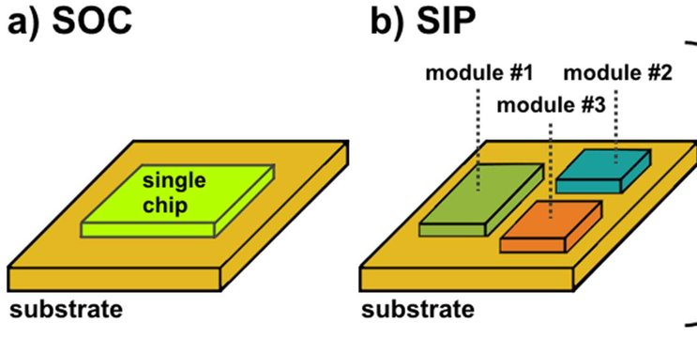
block diagram of
system on chip

Slide 9
Single die packaging:
it have a only one die.
1970s- traditional forms of packaging included a single die into a package.
Advantages: high performance.
Dis advantages: large, expensive, more-faults, more-power, longer interconnection.
Ex: Analog circuits, digital circuits, optical circuits

Slide 10
Multiple chip module :
a multi chip module is a electronic assembly (inter connection) of more die and discrete components are integrated.
It is also called “hybrid integration” and “ heterogeneous integration”.
it allows a manufacturer to use multiple components for modularity
Improve yields over a conventional monolicitic ic.
Disadvantages : high cost.
ex: IBM bubbles memory MCMs, IBM 3081 mainframe thermal conduction module.

Slide 11
System on chip:
it integrates most components of computer or other electronic system.
This components almost includes cpu, memory, peripherals, secondary storage.
Advantages: high performace, low power efficiency, minimized heat, minimized latancy.
disadvantages: complicated, resource intensive, low yield, no upgrading.
Ex :qualcomm snapdragon.

Slide 12
System in package
a sip in package, is a way bunding two or more ic inside the single package.
need for sip are miniaturization, DRAM, logic,digital, RF integrtation.
It uses 2.5D, 3D packaging, interposer and tsv technology. It can contain passive components embedded in substrate.

Slide 13
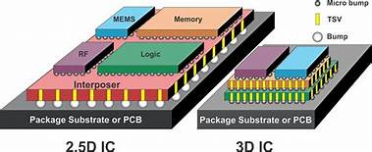
2.5 d ic:
A 2.5 D IC combines multiple integrated circuits in a single package without stacking
Silicon interposer between substrate and dies.
TSV and RDL to connect the dies to one another.
Horizontal integration on the interposer.
It is stepping stone for 3D.

Slide 14
Interposer:
Interposer - it is a electrical interface between substrate to dies. Made for electrical connection.
Silicon interposer - silicon interface substrate and dies. It can be active or passive.
Passive - communication among dies and input/output devices. Cannot perform function.
Active - communication among dies and input/output devices. functional chips embbeded in the silicon substrate.
Advantages- high wiring density, excellent electrical and thermal performance, low power.

Slide 15
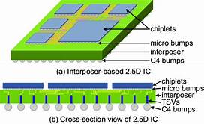
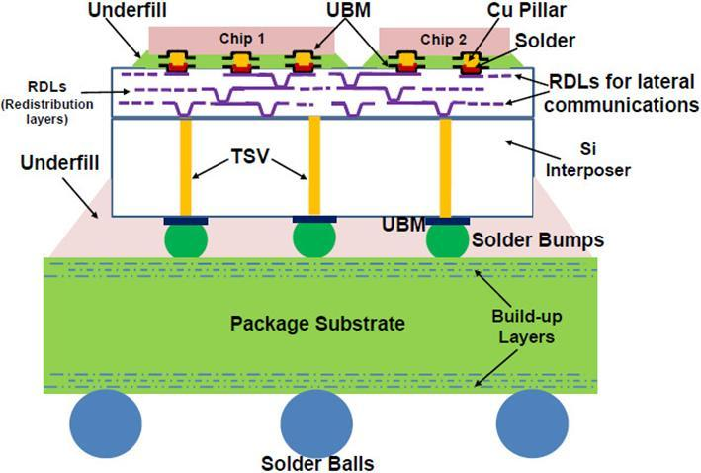

Slide 16
Through silicon vias:
It is one of the structure of interposer
vertical pathway through silicon interposer.
Aspect ratio- under 20 micro meter wide, up to 200 micro meter tall.
PROCESS: etching, oxidation, deposition, filling, and CMP(chemical method polish).
Redistribution layer-horizontal pathway along the inter poster.

Slide 17
ADVANTAGE OF 2.5:
Smaller size than traditional packing(2 d ic).
shorter interconnection.
High speed.
Low power usage
Better heat management
Interposer matches die CIE
Heterogeneous integration (simplified integration)

Slide 18
Disadvantage of 2.5ic:
it harder to integrate
Need more advance technologies
unreliable manufacturing
Need heat management techniques
High evaluate cost

Slide 19
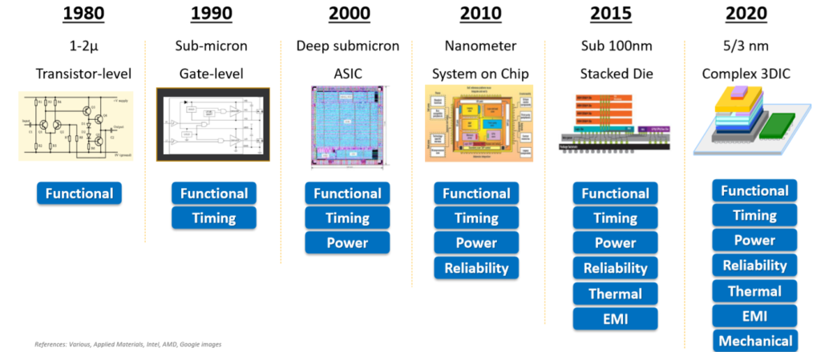
Evaluvation 3 D ic:

Slide 20
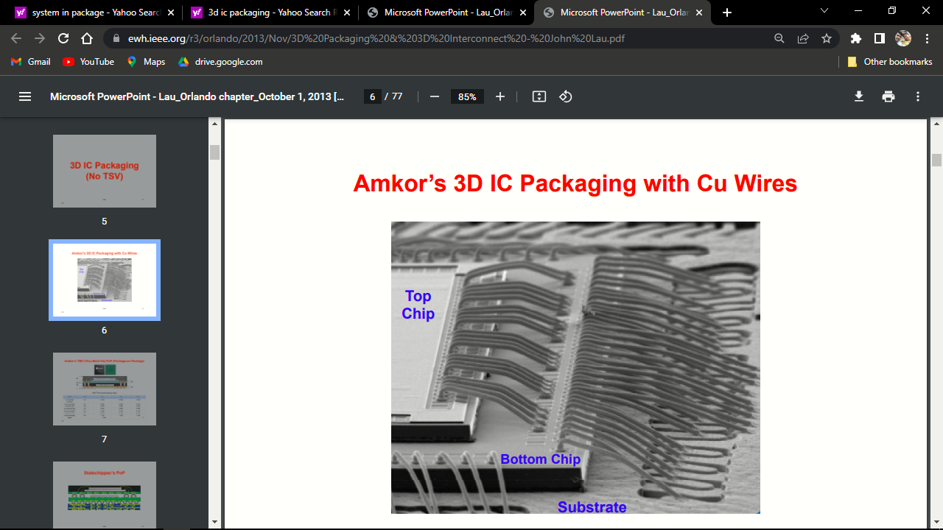
3d ic :
a 3 dimension integrated circuits composed of two or more layer of active electronic component horizontal and vertical.
Entire chip is divided into number of blocks and each blocks placed on separate layer of substrate. Stack on top of another.
A generic 3D ic structure has dies stacked on top of each another and are interconnected vertically using “TSV technology” .

Slide 21
Necessity of 3 D ic:
can accommodate homogeneous as heterogeneous chips
to reduce space wastage on the substrate.
Improve interconnection among different wafers.
To reduce length of interconnections which will also reduce heat dissipation
And RC delays.

Slide 22
Technology Used to Build 3D ICs
Monolithic
Wafer on Wafer
Die on Wafer
Die on Die

Slide 23
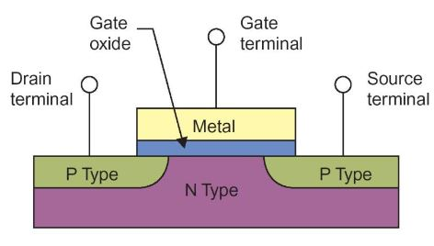
Monolithic:
Electronic components and their connections(wiring) are built in layers on a single semiconductor wafer, which is then diced into 3D ICs. There is only one substrate, hence no need for aligning, thinning, bonding, or through-silicon vias.

Slide 24
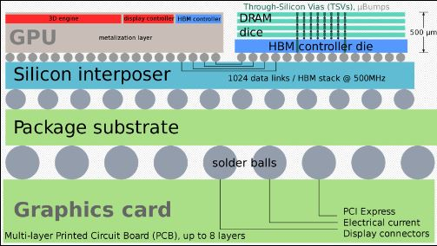
Wafer on wafer:
The electronic components are built on two or more wafers. The wafers are then bounded together
The through-silicon vias(TSVs) pass through the silicon substrate between active layers or between an active layer and an external pad.

Slide 25
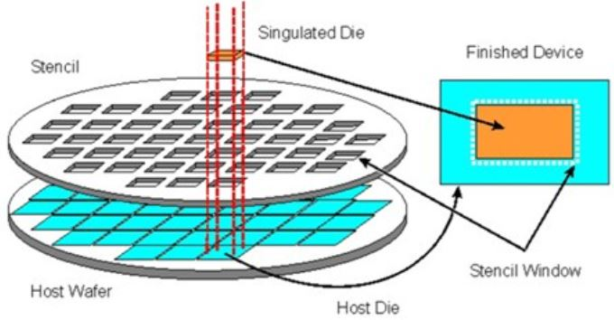
Die on Wafer
The electronic components are built on two different semiconductor wafers.
One wafer is diced and then stacked on the other wafer
Thinning and TSV creation are performed before or after bonding

Slide 26
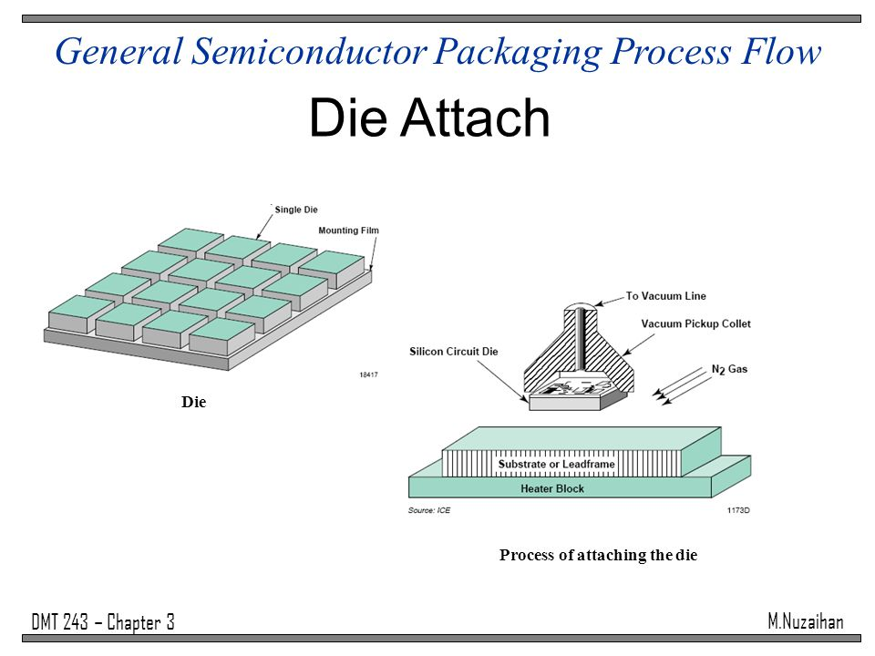
Die on Die
The electronic components are built on multiple dies,
these dies are aligned and bonded together
An advantage is that each component die can be tested first

Slide 27
Advantages of 3D
More smaller size.
Increased more functionality density.
Shorter wiring.
Reduced inter connect delay.
Low power consumption.
Reduced capacitance.
Allow for heterogeneous SOC design onto different dies.
Wide bandwidth

Slide 28
Disadvantges of 3d ic:
heat management.(reduce performance, heat flow, heat sinks, thermal vias and circuital wire routing).
High cost
TSV generate stress.
Design complexity.
Testing.

Slide 29
Thank you all

